Slide 1
MARS MDG-M China MW: As-Is & To-Be Process Flow for VERP
10th November 2023

Slide 2
Document Change History
Version | Date | Author | Amended Section(s) | Draft
1. | 10-11-2023 | Inchara T | All | Initial
2. | 23-11-2023 | Inchara T | Process update in Slides 6 & 10; Manual Fields & Automation Percentage details in Slide 19 | -
3. | 04-01-2024 | Inchara T | Addition of AP02 Field Maintenance scenario in Slide 16 | -
4. | 22-01-2024 | Inchara T | Modification (Removal of access to all the fields except Status field) for Finance Team in Slide 14 | Final

Slide 3
Table of Contents
Title | Slide No
Scenario 1 (VERP POMT 8 Pack Material Procured Externally - Veritas Scope) - ̶ As-Is Process ̶ To-Be Process: Plants/Sales Extension | 4 5
Scenario 2 (VERP POMT 8 Pack Material Procured Externally - Out of Veritas Scope) - ̶ As-Is Process ̶ To-Be Process: Code Creation ̶ To-Be Process: General Data Change (Optional) ̶ To-Be Process: Plants/Sales Extension | 6 7 8 9
Scenario 3 (VERP POMT 1 Phantom Packaging Material - Out of Veritas Scope) - ̶ As-Is Process ̶ To-Be Process: Code Creation ̶ To-Be Process: General Data Change (Optional) ̶ To-Be Process: Plants Extension | 10 11 12 13
To-Be Process: Field Maintenance (VERP) | 14

Slide 4
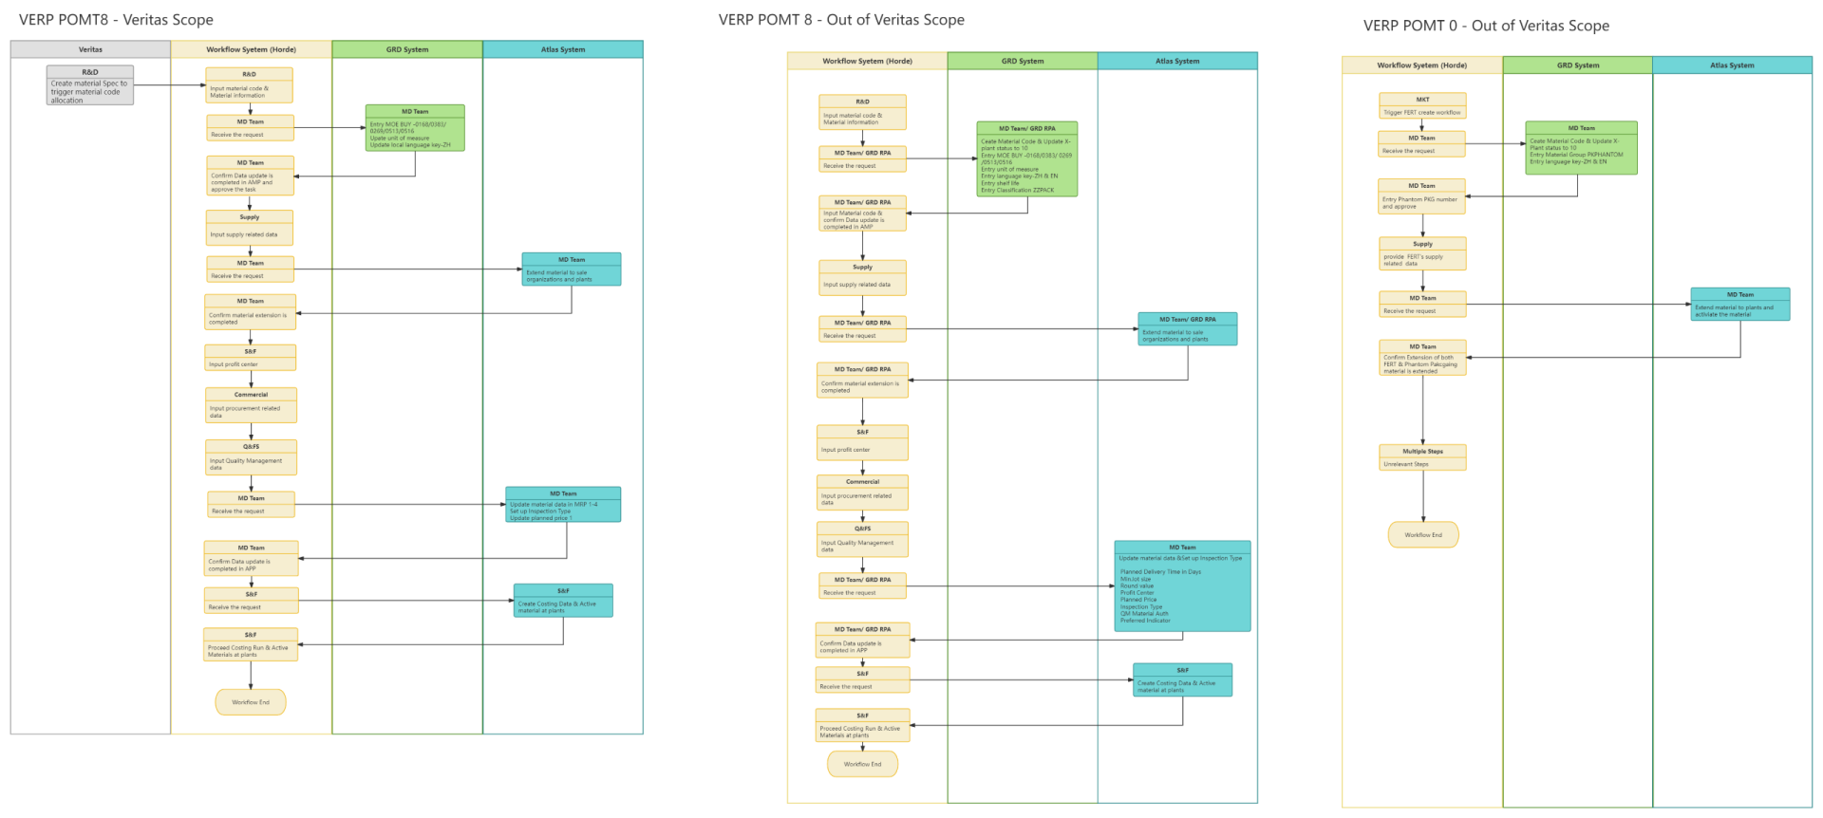
As-Is Process: VERP POMT 8 Pack Material Procured Externally - Veritas Scope
Note: Maintenance of MOE Usage Code BUY will be moved from GRD to MDG in future.

Slide 5
To-Be Process: Plants/Sales Extension – VERP POMT 8 Pack Material Procured Externally - Veritas Scope
START
Workflow System (Horde)
VERP POMT 8
Total Unique fields | 47
Editable fields | 11
Automation % | 76
Supply
MDG System
Code Creation & Basic Data Update
Input supply related data
MD
MD
MDG Change Request(CR TYPE ZMPLNT02) created.
Extend material to plants and sales view.
Atlas System
Receive the request
MDG CR Auto approved
MD
S&F, Commercial and Q&FS
Set up Inspection Type
Update planned price 1, QM Material Auth, Preferred Indicator
Input profit center
Input procurement related data
Input quality management data
MD
MDG Change Request(CR TYPE - ZMPLTCHG) created.
Update material data in MRP 1-4 & Profit Center
S&F
MD
Create Costing Data
Receive the request
MD
Confirm Data update is completed in APP
MDG System
S&F
Receive the request
S&F
S&F
MDG Change Request(CR TYPE - ZMPLTCHG) created.
Active material at plants
Proceed Costing run & Active materials at plants
END
Note: The Plants/ Sales Extension can also be done using Chatbot

Slide 6
As-Is Process: VERP POMT 8 Pack Material Procured Externally - Out of Veritas Scope

Slide 7
To-Be Process: Code Creation – VERP POMT 8 Pack Material Procured Externally – Out of Veritas Scope
START
MDG System
Workflow System (Horde)
MD
R&D
Code Allocation (CR TYPE: ZZMAT01) & Update X-plant status to 10
Enter MOE (BUY – 0168/0383/0269/0513/0516)
Enter unit of measure
Enter local language key – ZH & EN
Enter Shelf life
Enter Classification (ZZPACK)
Input material code & Material information
MD
Received the request
MDG CR Auto approved
END

Slide 8
To-Be Process: General Data Change (Optional) – VERP POMT 8 Pack Material Procured Externally – Out of Veritas Scope
START
MDG System
MD
MDG Change Request(CR TYPE: ZZMAT02) created
Update fields as per business requirement.
MDG CR Auto approved
END

Slide 9
To-Be Process: Plants/Sales Extension – VERP POMT 8 Pack Material Procured Externally – Out of Veritas Scope
START
Workflow System (Horde)
VERP POMT 8
Total Unique fields | 47
Editable fields | 11
Automation % | 76
Supply
MDG System
Code Creation/ General Data Change
Input supply related data
MD
MD
MDG Change Request(CR TYPE ZMPLNT02) created.
Extend material to plants and sales view.
Atlas System
Receive the request
MDG CR Auto approved
MD
S&F, Commercial and Q&FS
Set up Inspection Type
Update planned price 1, QM Material Auth, Preferred Indicator
Input profit center
Input procurement related data
Input quality management data
MD
MDG Change Request(CR TYPE - ZMPLNTCHG) created.
Update material data MRP 1-4 & Profit Center
S&F
MD
Create Costing Data
Receive the request
MD
Confirm Data update is completed in APP
MDG System
S&F
Receive the request
S&F
S&F
MDG Change Request(CR TYPE - ZMPLTCHG) created.
Active material at plants
Proceed Costing run & Active materials at plants
END
Note: The Plants/ Sales Extension can also be done using Chatbot

Slide 10
As-Is Process: VERP POMT 1 Phantom Packaging Material - Out of Veritas Scope

Slide 11
To-Be Process: Code Creation – VERP POMT 1 Phantom Packaging Material – Out of Veritas Scope
START
MDG System
Workflow System (Horde)
MD
MKT
Code Allocation (CR TYPE: ZZMAT01) & Update X-plant status to 10
Enter Material Group – PKPHANTOM
Enter local language key – ZH & EN
Trigger FERT create workflow
MD
Received the request
MDG CR Auto approved
END

Slide 12
To-Be Process: General Data Change (Optional) – VERP POMT 1 Phantom Packaging Material – Out of Veritas Scope
START
MDG System
MD
MDG Change Request(CR TYPE: ZZMAT02) created
Update fields as per business requirement.
MDG CR Auto approved
END

Slide 13
To-Be Process: Plants Extension – VERP POMT 1 Phantom Packaging Material – Out of Veritas Scope
START
VERP POMT 1
Total Unique fields | 30
Editable fields | 6
Automation % | 80
MDG System
Creation / General Data Change
MD
Workflow System (Horde)
MDG Change Request(CR TYPE ZMPLNT02) created.
Extend material to plants view.
Workflow System (Horde)
MD
Confirm Extension of both FERT & Phantom Packaging material is extended
Supply
Input FERT’s supply related data
MDG CR Auto approved
Multiple
Irrelevant Steps
MD
Receive the request
END
Note: The Plants/ Sales Extension can also be done using Chatbot

Slide 14
To-Be Process : Field Maintenance – VERP
Note:
Plant specific material Status update is not needed for VERP POMT 1 scenario (Phantom) materials since they are defaulted with 20 during extension as there is no costing run.
Supply Group and Finance Team will be able to view and edit only specific fields which involves them.
START
MDG System
MD
Supply Group
Finance Team
MDG Change Request created (CR TYPE - ZMPLTCHG)
Can modify all MDG owned Plant/Sales Data fields in scope.
MDG Change Request created (CR TYPE - ZMPLTCHG)
Can modify MDG owned MRP and WM fields in scope.
MDG Change Request created (CR TYPE - ZMPLTCHG)
Can update Plant Specific Material Status from 03 to 20, after costing run.
Atlas System
MDG CR Auto approved
MD, Supply Group, Finance Team
Optional Step
Validate MDG updated records if required.
END

Slide 15
Appendix
10th November 2023

Slide 16
China MW – VERP Scenario, Sales Organization, Warehouses & Plants Description
Sales Organization Description
Scenario Description
A0IO – VERP POMT 1 Phantom Packaging Material
A0IP – VERP POMT 8 Pack Material Procured Externally
A0IQ – VERP AP02 Extension
A0IR – VERP Field Maintenance – MD
A0IS – VERP Field Maintenance - Supply
A0IT – VERP Field Maintenance – Finance
A0KY – VERP AP02 FIELD MAINTENACE – MD
135 – Mars Foods (China)
234 – Mars Foods (Jiaxing)
456 – MWC China
601 – Wrigley Confect. Com
Warehouses Description
113 – Warehouse Shanghai (CN)
128 – Warehouse YongHe (CN)

Slide 17
China MW – VERP Scenario, Sales Organization & Plants Description:
Plants Description
AP02 - Asia Pac Choc Central Plant CN01 - HUA Snackfood Plant CN11 - CN Logical Plant CN15 - HUA Snack Crossdock Plant CN16 - Airport City Logisitic Park CN17 - JXG Snackfood Plant CN18 - JXG Inb W/H CN19 - DHL Jiaxing CN21 - DHL Nanjing CN22 - Guangzhou Wushi Village WH CN23 - JXG Sinotrans KIND W/H CN24 - JXG Sinotrans Inb W/H CN37 - Sunssi CN40 - JXG Kind Plant CN46 - KIND China Shanghai CN47 - KIND China Tianjin CN48 - KIND China Guangzhou CN49 - KIND China Chengdu CN61 - MWCC Tianjin CDC CN62 - MWCC Jiaxing CDC CN63 - MWCC Guangzhou NDC CN64 - MWCC Shanghai NDC CN65 - MWCC Chengdu RDC-CHO CN66 - MWCC Guangzhou RDC-CHO CN67 - MWCC Shenyang RDC-CHO | CN68 - MWCC Wuhan RDC-CHO CN69 - MWCC Chengdu RDC-WWY CN70 - MWCC Kunming RDC-WWY CN71 - MWCC GuangZhou RDC-WWY CN72 - MWCC Shanghai RDC-WWY CN73 - Ice Cream Shanghai CDC CN74 - MWCC Urumuqi RDC-WWY CN75 - Ice Cream Guangzhou RDC CN76 - MWCC Xian RDC-WWY CN77 - MWCC Zhengzhou RDC-WWY CN79 - Ice Cream Beijing RDC CN80 - MWCC Beijing WWY RDC CN91 - Multizen Industry(Nantong)Ltd CN92 - Emma Industry(Suzhou)Ltd CN93 - JiaXing WISEMAX Food Ltd. CN94 - JiaXing WISEMAX Food Ltd. CNA6 - Multizen Industry(Nantong)Ltd CNB1 - Mars Wrigley SON BASE CNB2 - Mars Wrigley SON FG CNB3 - CHN ExMan YaSheng CNB4 - CHN ExMan Yishi CNB5 - Mars Wrigley YongHe Plant CNB6 - CHN ExMan HongXin CNB7 - CHN ExMan ZiRun CNB8 - CHN ExMan TaoRen

Slide 18
China MW – VERP Manual/Editable Fields & Automation Percentage:
VERP POMT 8 Pack Material Procured Externally |  | VERP POMT 1 Phantom Packaging Material |  | VERP AP02 EXTENSION
Field | Field Description | Field | Field Description | Field | Field Description
DISLS DISMM DISPO EISBE EKGRP EPRIO FABKZ KZDKZ LGFSB PRCTR SHZET SOBSL | Lot size MRP Type MRP controller Safety stock Purchasing group Stock Determination Group JIT Delivery Schedules Documentation Required Storage Location Ext. Procurement Profit Center Safety time Special procurement | DISLS EISBE EKGRP LGFSB PLIFZ PRCTR | Lot size Safety stock Purchasing group Storage Location Ext. Procurement Planned delivery time in days Profit Center | KZDKZ | Documentation Required
VERP POMT 8
Total Unique fields | 47
Editable fields | 11
Automation % | 76
VERP POMT 1
Total Unique fields | 30
Editable fields | 6
Automation % | 80
VERP AP02
Total Unique fields | 2
Editable fields | 1
Automation % | 50
Overall Automation % | 69

Slide 19
Data Synchronization Process
Basic Data (GRD to MDG):
GRD->MDG replication for basic data is completed in around 15 minutes.
GRD->ATLAS replication for basic data, is completed in 15 minutes.
Basic Data (MDG to GRD) :
MDG->GRD replication for basic data is completed in Real Time.
GRD->MDG replication for basic data is completed in around 15 minutes.
GRD->ATLAS replication for basic data, is completed in 15 minutes.
Plant & Sales Extension:
MDG->ATLAS replication for plant/sales data is completed in Real Time.
ATLAS->MDG sends acknowledgement every 5 minutes.

Slide 20
Thank You
10th November 2023

